Slide 1
자료구조 및 알고리즘 - Sorting
Taehyoun Kim
Dept. of Mechanical & Information Engineering,
University of Seoul

Slide 2
Sorting in General
Sorting
Permuting a sequence of records into ascending order of keys.
The keys are only part (often a small part) of the records.
Internal vs. External Sorting
If the file containing the records to be sorted will fit into memory, then the sorting method is called internal.
Sorting files from disk is called external sorting.
Indirect sorting
If the records to be sorted are large, it is wise to avoid shuffling them around by doing an indirect sort.
The idea is to sort the indices of the records, rather than the records themselves.

Slide 3
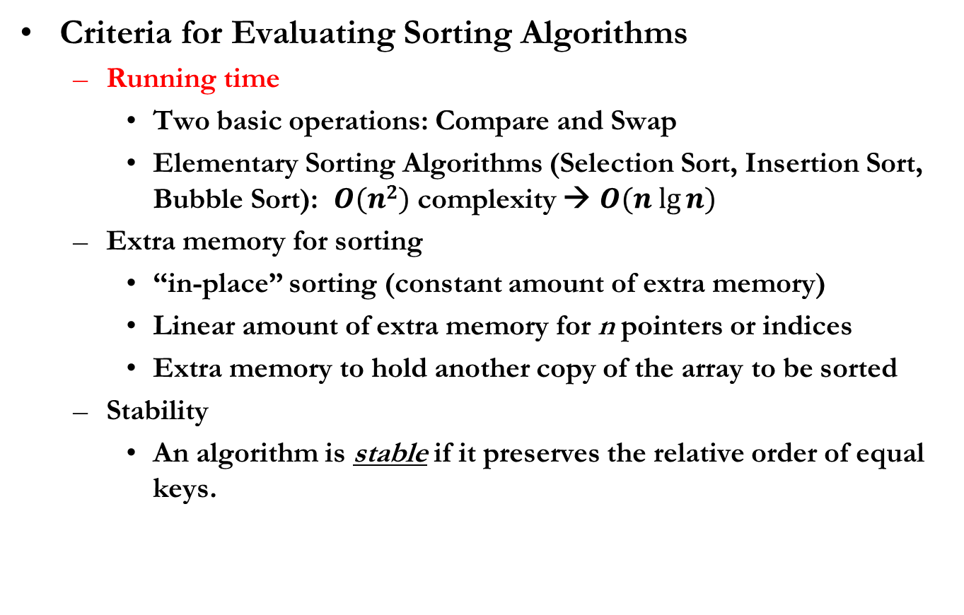
Sorting in General
Criteria for Evaluating Sorting Algorithms
Running time
Two basic operations: Compare and Swap
Elementary Sorting Algorithms (Selection Sort, Insertion Sort, Bubble Sort): $O(n2)$ complexity → $O(n lg⁡n)$
Extra memory for sorting
“in-place” sorting (constant amount of extra memory)
Linear amount of extra memory for n pointers or indices
Extra memory to hold another copy of the array to be sorted
Stability
An algorithm is stable if it preserves the relative order of equal keys.

Slide 4
Selection Sort
The Selection Sort algorithm works as follows:
Find the minimum value in the list
Swap it with the value in the first position
Repeat the steps above for the remainder of the list
starting at the second position and advancing each time

Slide 5
Selection Sort
- 1st
before
69
10
30
2
16
8
31
22
after
2
10
30
69
16
8
31
22
- 2nd
before
2
10
30
69
16
8
31
22
after
2
8
30
69
16
10
31
22
- 3rd
before
2
8
30
69
16
10
31
22
after
2
8
10
69
16
30
31
22
- …

Slide 6
Selection Sort

Slide 7
Selection Sort
void
selection_sort(int a[ ], int n)
{
int min, minIndex;
int i, j;
for( i=0 ; i < n-1 ; i++ ) {
minIndex = i;
min = a[i];
for( j=i+1 ; j < n ; j++ ) {
if( min > a[j] ) {
minIndex = j;
min = a[j];
}
}
a[minIndex] = a[i];
a[i] = min;
}
}
Best case ?
Worst case ?
Notes:
Stability (X)
Best: 정렬된 상태 ( 비교: N(N-1)/2, 교환: 0 )
Worst: 16,15,13,14, 9,10,11,12, 1,2,3,4,5,6,7,8 (비교:N/(N-1)/2, 교환:N/2 + N/4 + N/8 + +1 = N-1)
Average: 역순정렬 (비교: N(N-1)/2, 교환: N/2 )

Slide 8
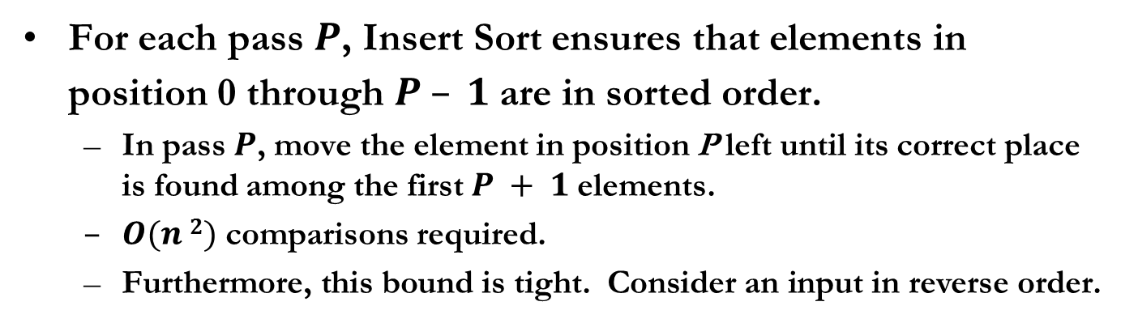
Insertion Sort
Sorted partial result
Unsorted data
≤ x
> x
x
…
Sorted partial result
Unsorted data
≤ x
x
> x
…
For each pass $P$, Insert Sort ensures that elements in position 0 through $P – 1$are in sorted order.
In pass $P$, move the element in position P left until its correct place is found among the first $P + 1$elements.
$O(n 2)$ comparisons required.
Furthermore, this bound is tight. Consider an input in reverse order.

Slide 9
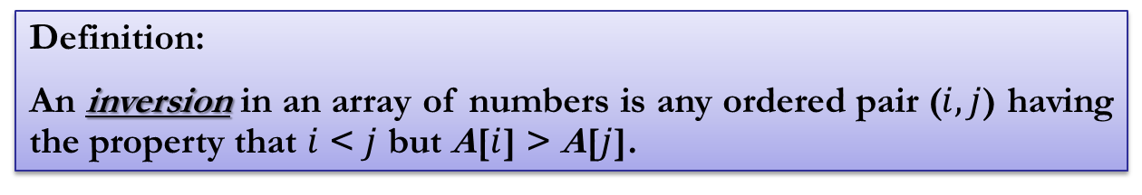
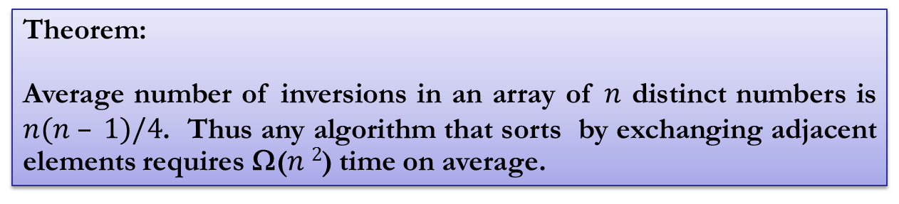
Insertion Sort
Lower bounds
Definition:
An inversion in an array of numbers is any ordered pair ($i, j$) having the property that $i$ < $j$ but A[$i$] > A[$j$].
Theorem:
Average number of inversions in an array of $n$ distinct numbers is $n(n – 1)/4$. Thus any algorithm that sorts by exchanging adjacent elements requires Ω($n 2$) time on average.
Notes:
avg no. of inversions = n(n-1)/4 증명: 어떤 sequence와 그 sequence의 reverse sequence를 가정할 때, sequence의 서로 다른 두 원소는 inversion이거나 아니거나 둘 중 하나. 원래 sequence에서 inversion이 아니면 reverse sequence에서 inversion, vice versa. 서로 다른 원소쌍은 모두 n(n-1)/2 개가 존재하므로 평균 n(n-1)/4 만큼의 inversion이 존재

Slide 10
Insertion Sort
S
U
- 1st
before
69
10
30
2
16
8
31
22
S
U
after
10
69
30
2
16
8
31
22
S
U
- 2nd
before
10
69
30
2
16
8
31
22
S
U
after
10
30
69
2
16
8
31
22
S
U
- 3rd
before
10
30
69
2
16
8
31
22
S
U
after
2
10
30
69
16
8
31
22
- …

Slide 11
Insertion Sort

Slide 12
Insertion Sort
void
insertion_sort(int a[ ], int n)
{
int i, j;
int temp;
for( i=1 ; i < n ; i++ ) {
temp = a[i];
for ( j = i ; j > 0 && a[j-1] > temp ; j-- )
a[j] = a[j-1];
a[j] = temp;
}
}
Best case ?
Worst case ?
Notes:
Stability (O)
Best: 정렬된 상태 ( 비교: N, 교환: 0 )
Worst: 역순정렬 ( 비교: N(N-1)/2, 교환: N(N-1)/2 )

Slide 13

Bubble Sort
Go through the array in order, swapping two elements if they are out of order (A[$j−1$] > A[$j$]).
And, repeat until no swaps are performed.
For $n$ items, $n$ passes are suffice to complete the procedure.

Slide 14
Bubble Sort
- 1st
- 2nd
69
10
30
2
16
8
31
22
10
30
2
16
8
31
22
69
10
69
30
2
16
8
31
22
10
30
2
16
8
31
22
69
10
30
69
2
16
8
31
22
10
2
30
16
8
31
22
69
10
30
2
69
16
8
31
22
10
2
16
30
8
31
22
69
10
30
2
16
69
8
31
22
10
2
16
8
30
31
22
69
10
30
2
16
8
69
31
22
10
2
16
8
30
31
22
69
10
30
2
16
8
31
69
22
10
2
16
8
30
22
31
69
10
30
2
16
8
31
22
69
- 3rd
10
2
16
8
30
22
31
69
2
10
16
8
30
22
31
69
2
10
16
8
30
22
31
69
- …
2
10
8
16
30
22
31
69
2
10
8
16
30
22
31
69
2
10
8
16
22
30
31
69

Slide 15
Bubble Sort

Slide 16
Bubble Sort
void
bubble_sort(int a[ ], int n)
{
int i, j;
int temp;
for( i=0 ; i < n-1 ; i++ ) {
for( j=0; j < n-i-1; j++ ){
if( a[j] > a[j+1] ) {
temp = a[j];
a[j] = a[j+1];
a[j+1] = temp;
}
}
}
}
Best case ?
Worst case ?
Notes:
Stability (O)
Best: 정렬된 상태 ( 비교: N(N-1)/2, 교환: 0 )
Average, Worst: 역순정렬 ( 비교: N(N-1)/2, 교환: N(N-1)/2 )

Slide 17
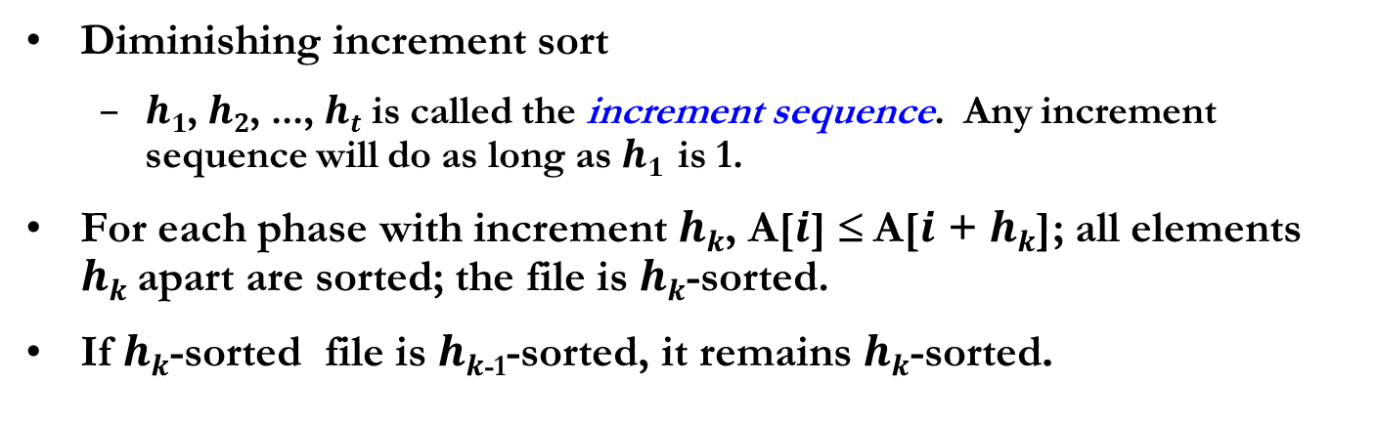
Shell Sort
Diminishing increment sort
$h1$, $h2$, ..., $ht$ is called the increment sequence. Any increment sequence will do as long as $h1$ is 1.
For each phase with increment $hk$, A[$i$] ≤ A[$i$ + $hk$]; all elements $hk$apart are sorted; the file is $hk$-sorted.
If $hk$-sorted file is $hk$₋₁-sorted, it remains $hk$-sorted.
0 1 2 3 4 5 6 7 8 9 10 11 12
Original 81 94 11 96 12 35 17 95 28 58 41 75 15
After 5-sort 35 17 11 28 12 41 75 15 96 58 81 94 95
After 3-sort 28 12 11 35 15 41 58 17 94 75 81 96 95
After 1-sort 11 12 15 17 28 35 41 58 75 81 94 95 96

Slide 18
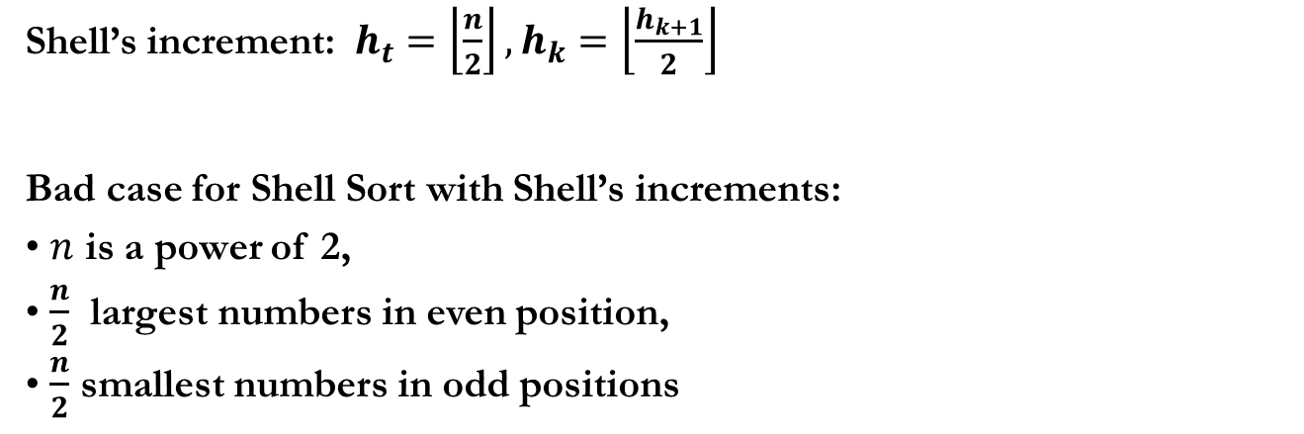
Shell Sort – Increment Sequence
Shell’s increment: $h_{t}=\left\lfloor \frac{n}{2}\right\rfloor , h_{k}=\left\lfloor \frac{h_{k+1}}{2}\right\rfloor$
Bad case for Shell Sort with Shell’s increments:
$n$ is a power of 2,
$\frac{n}{2}$ largest numbers in even position,
$\frac{n}{2}$ smallest numbers in odd positions
Original 1 9 2 10 3 11 4 12 5 13 6 14 7 15 8 16
After 8-sort 1 9 2 10 3 11 4 12 5 13 6 14 7 15 8 16
After 4-sort 1 9 2 10 3 11 4 12 5 13 6 14 7 15 8 16
After 2-sort 1 9 2 10 3 11 4 12 5 13 6 14 7 15 8 16
After 1-sort 1 2 3 4 5 6 7 8 9 10 11 12 13 14 15 16
What is the number of inversions in the list above?
Notes:
18

Slide 19
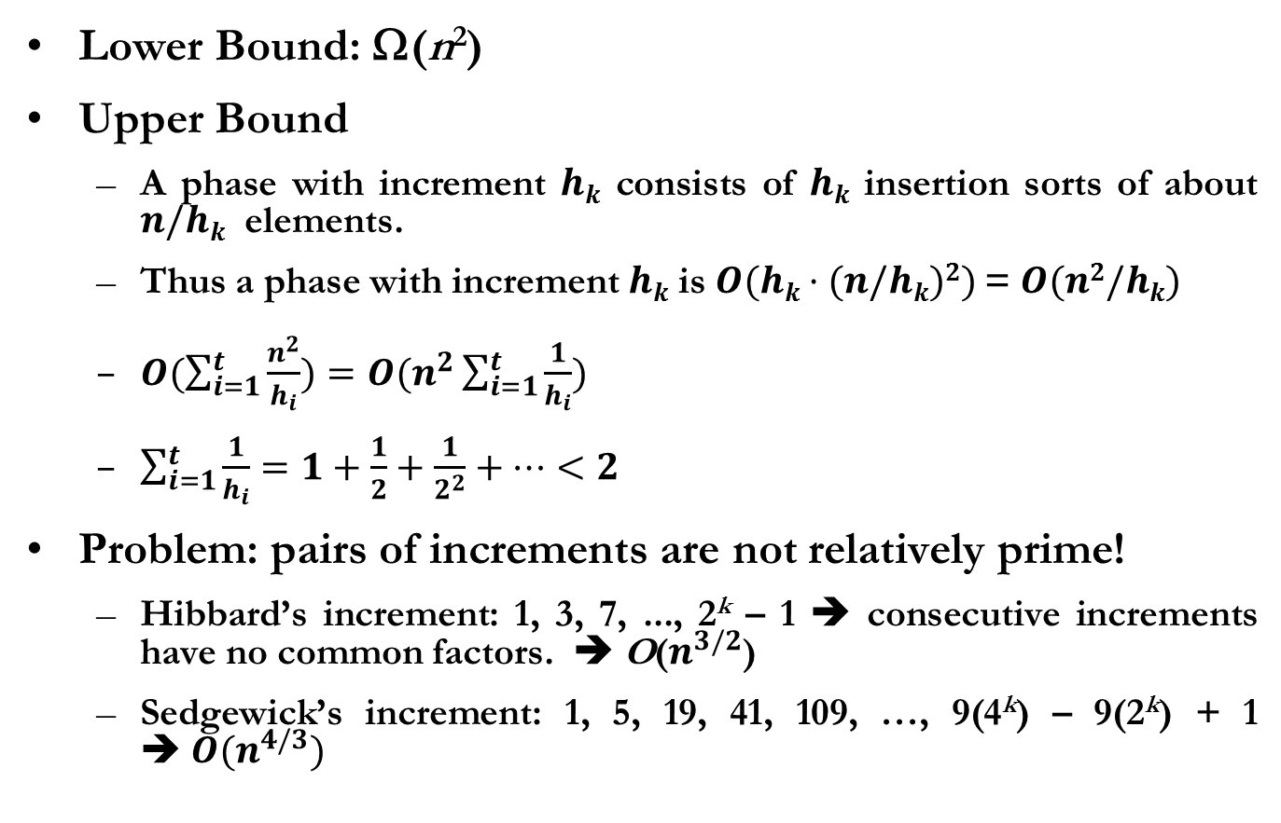
Analysis of Shell Sort
Lower Bound: Ω(n²)
Upper Bound
A phase with increment $hk$ consists of $hk$ insertion sorts of about $n/hk$ elements.
Thus a phase with increment $hk$ is $O(hk·(n/hk)2)$= $O(n2/hk)$
$O(\sum_{i=1}^{t}{\frac{n^{2}}{h_{i}})}=O(n^{2}\sum_{i=1}^{t}{\frac{1}{h_{i}})}$
$\sum_{i=1}^{t}{\frac{1}{h_{i}}=1+\frac{1}{2}+\frac{1}{2^{2}}+…<2}$
Problem: pairs of increments are not relatively prime!
Hibbard’s increment: 1, 3, 7, ..., 2^{k} – 1 ➔ consecutive increments have no common factors. ➔ O($n^{3/2}$)
Sedgewick’s increment: 1, 5, 19, 41, 109, …, 9(4^{k}) – 9(2^{k}) + 1 $➔ O(n^{4/3})$
Notes:
이것은 tight bound 임. Proof by V. Pratt & Sedgewick
(2^k-1)과 (2^k+1 -1)은 서로 소: (proof by contradiction) d로 나누었을 때 두 수가 모두 module 0 이라고 가정. 그러면 두 수의 차이도 mod d = 0.
그런데 두수의 차이는 2^k. 2^k의 약수는 모두 2의 배수, 그러나 2^k-1은 반드시 홀수.

Slide 20
Heap Sort
Basic Strategy
Build binary heap of n elements → O($n$)
$n$ DeleteMin operations → $O\left(nlog{n}\right)$
Each deleted item is copied to a second array.
After then, the elements are copied back to the original array.
Problem: use of extra array
Solution: make use of the last cell in the previous heap.
Results in a (max) heap

Slide 21
Heap Sort
97
(max) Heap
 | 97 | 53 | 59 | 26 | 41 | 58 | 31
53
59
0 1 2 3 4 5 6 7 8 9 10 11
26
41
58
31
After first DeleteMax
59
 | 59 | 53 | 58 | 26 | 41 | 31 | 97
53
58
0 1 2 3 4 5 6 7 8 9 10 11
26
41
31
97

Slide 22
Heap Sort (Code)
void PercolateDown(int A[], int i, int N)
{
int Child, Tmp;
for( Tmp = A[i] ; LeftChild(i) <= N ; i = Child ) {
Child = LeftChild(i);
if(Child != N && (A[ Child + 1 ] > A[ Child ] )) /* Max Heap !!! */
Child++;
if(tmp < A[ Child ]) A[ i ] = A[ Child ];
else break; /* The heap-order property is met. Then exit. */
}
A[ i ] = tmp;
}
void Heapsort (int A[], int N)
{
int i;
for (i = N/2 ; i > 0 ; i--) /* Build(Max)Heap */
PercolateDown (A, i, N);
for( i = N; i > 1 ; i--) {
swap (&A[0], &A[i]); /* DeleteMax */
PercolateDown(A, 0, i);
}
}
Notes:
원래의 슬라이드의 오류 수정하여 빨간색 표시함
#define LeftChild(i) (2*(i))
Or
inline int LeftChild(i)
{
return 2*I;
}

Slide 23
Merge Sort
Idea: merge two sorted lists using temporary array.
If the number of element is one, return;
Otherwise, recursively merge sort the first half and the second half.
The two sorted halves are merged together
Typical “Divide-and-Conquer” Approach

Slide 24
Merge Sort
Merging
: Compare A[Aptr] and B[Bptr], then copy the smallest value to C[Cptr]
1 | 13 | 24 | 26
2 | 15 | 27 | 38
Aptr
Bptr
Cptr
1 | 13 | 24 | 26
2 | 15 | 27 | 38
1
Aptr
Bptr
Cptr
1 | 13 | 24 | 26
2 | 15 | 27 | 38
1 | 2
Aptr
Bptr
Cptr
1 | 13 | 24 | 26
2 | 15 | 27 | 38
1 | 2 | 13
Aptr
Bptr
…
Cptr
1 | 13 | 24 | 26
2 | 15 | 27 | 38
1 | 2 | 13 | 15 | 24 | 26
Aptr
Bptr
Cptr
1 | 13 | 24 | 26
2 | 15 | 27 | 38
1 | 2 | 13 | 15 | 24 | 26 | 27 | 38
Aptr
Bptr
Cptr

Slide 25
Merge Sort
Divide
69
10
30
2
16
8
31
22
69
10
30
2
16
8
31
22
Recursive Call
69
10
30
2
16
8
31
22
69
10
30
2
16
8
31
22
Combine
(Merge)
69
10
30
2
16
8
31
22
1
10
69
30
2
16
8
31
22
2
10
69
2
30
16
8
31
22
3
4
2
10
30
69
8
16
31
22
5
2
10
30
69
8
16
22
31
6
2
10
30
69
8
16
22
31
7
2
8
10
16
22
30
31
69

Slide 26
Merge Sort (Code)
void Msort (int A[], int temp[], int Left, int Right)
{
int Center;
if (Left < Right) {
Center = (Left + Right) / 2;
Msort(A, temp, Left, Center);
Msort(A, temp, Center+1, Right);
Merge(A, temp, Left, Center+1, Right);
}
}
void Mergesort (int A[], int N)
{
int *TmpArray;
/* memory allocation for temporary array
which amounts to N */
…
Msort (A, TmpArray, 0, N-1);
}
void Merge (int A[], int temp[], int lPos, int rPos, int rEnd)
{
int lEnd = rPos-1;
int tmpPos = lPos;
int i, nrItems = rEnd – lPos + 1 ;
/* main loop */
while (lPos <= lEnd && rPos <= rEnd)
if (A[lPos] <= A[rPos])
temp[tmpPos++] = A[lPos++];
else
temp[tmpPos++] = A[rPos++];
/* copy the rest items */
while (lPos <= lEnd)
temp[tmpPos++] = A[lPos++];
while (rPos <= rEnd)
temp[tmpPos++] = A[rPos++];
/* Copy temp array back */
for (i = 0; i < nrItems; i++, rEnd--)
a[rEnd] = temp[rEnd];
}

Slide 27
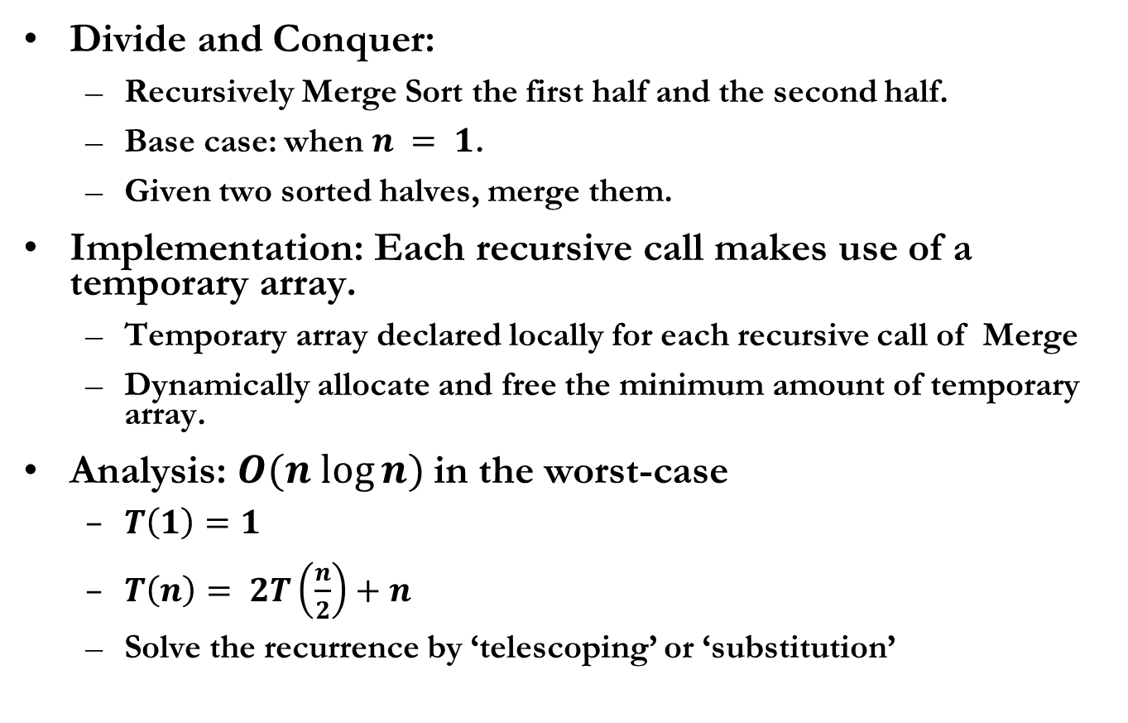
Merge Sort - Analysis
Divide and Conquer:
Recursively Merge Sort the first half and the second half.
Base case: when $n = 1$.
Given two sorted halves, merge them.
Implementation: Each recursive call makes use of a temporary array.
Temporary array declared locally for each recursive call of Merge
Dynamically allocate and free the minimum amount of temporary array.
Analysis: $O(n log⁡n)$in the worst-case
$T\left(1\right)=1$
$T\left(n\right)= 2T\left(\frac{n}{2}\right)+n$
Solve the recurrence by ‘telescoping’ or ‘substitution’
Notes:
Extra memory 필요

Slide 28
Quick Sort
Divide-and-Conquer for sorting subarray $A[l..r]$
Divide: partition the array $A[l..r]$into two subarrays $A[l..p−1]$and $A[p+1..r]$such that all elements in $A[l..p−1]$are less than or equal to a pivot element $A[p]$, which is, in turn, less than or equal to $A[p+1..r].$
Conquer: Sort the two subarrays $A[l..p−1]$and $A[p+1..r]$by recursive calls to Quick Sort.
Combine: Since the subarrays are sorted in place, no work is needed.
43
57
75
Select pivot
43
57
75
13
31
13
31
81
92
26
0
81
92
26
0
65
65
quicksort
quicksort
partition
0 13 26 31 43 57
65
75 81 92
13
43
65
31
0
75
92
57
26
81
0 13 26 31 43 57 65 75 81 92
Notes:
Average: O(NlogN)
Worst-case: O(N^2)
BST 경우를 생각해 보자. Root 를 기준으로 L tree와 R tree의 대소관계가 확실히 구분된다. Pivot이 BST의 root 역할을 함.

Slide 29
Partitioning For Quick Sort
Shaded region: not yet partitioned, Unshaded region: partitioned
pivot = 6
A[l..r]
8
1
4
9
0
3
5
2
7
6
i
j
8
1
4
9
0
3
5
2
7
6
swap
2
1
4
9
0
3
5
8
7
6
i
j
i
j
2
1
4
9
0
3
5
8
7
6
swap
2
1
4
5
0
3
9
8
7
6
i
j
i
j
A[l..p-1]
A[p+1..r]
2
swap
2
1
1
4
4
5
5
0
0
3
3
9
8
7
6
2
1
4
5
0
3
6
8
7
9
with pivot
j
i
i
Notes:
29

Slide 30
Picking the Pivot
Use the first element → worst if the input is presorted or in reverse order
Choose the pivot randomly → safe, but does not reduce the average running time while random number generation is costly.
Median-of-Three → randomness does not help here, either. Choose the median of the leftmost, rightmost, and center elements;
- What happens with the presorted input?
- Experiment shows that the running time is reduced by about 5 percent.
Notes:
30

Slide 31
Quick Sort (Code)
/* Return median of Left, Center, and
Right (pivot)
Order them and hide the pivot */
int Median3 (int A[], int l, int r)
{
int m = (l + r) / 2;
if ( A[l] > A[m] )
Swap( &A[l], &A[m]);
if ( A[l] > A[r] )
Swap( &A[l], &A[r]);
if ( A[m] > A[r] )
Swap( &A[m], &A[r]);
/* Now, A[l] <= A[m] <= A[r] */
Swap( &A[m], &A[r-1] );
/* return pivot value */
return A[r-1];
}
void Quicksort(int A[], int l, int r)
{
int pivot, i, j;
if (l >= r) return;
/* Select pivot value */
pivot = Median3(A, l, r);
i = l;
j = r - 1;
/* Partitioning */
for( ; ; ) {
while( A[++i] < pivot );
while( A[--j] > pivot );
if ( i < j )
Swap(&A[i], &A[j]);
else
break;
}
/* Restore pivot value */
if (i < r-1)
Swap (&A[i], &A[r-1]);
Quicksort(A, l, i-1);
Quicksort(A, i+1, r);
}
Notes:
31

Slide 32

Performance of Quick Sort
$$T\left(n\right)= T\left(i\right)+ T\left(n – i – 1\right)+ n, (T(0) = T(1) =1)$$
Performance depends on the selection of pivot
$$T\left(n\right)=T\left(n−1\right)+n$$
$$=T\left(n−2\right)+n−1+n$$
$$=T\left(1\right)+\sum_{i=2}^{n}{i}=O(n^{2})$$
$$T\left(n\right)=2T\left(n/2\right)+n$$
$$=4T\left(n/4\right)+2n$$
$$=n\log{n}+n= O(n\log{n)}$$
Worst-case partitioning: divide $n – 1$and pivot
Best-case partitioning: divide $n/2$ and $n/2$ elements
Notes:
32

Slide 33
Performance of Quick Sort
Average-case partitioning
Assume that the size of a partition is equally likely (that is, probability is $1/n$)
The average value of $T(i)$ or $T(n – i – 1)$is
$T\left(n\right)= \frac{2}{n}\left[\sum_{j=0}^{n−1}{T(j)}\right]+n$
We already know $T(n) = O(n log⁡n)$from the average case analysis of unbalanced binary search tree.
This average performance requires good selection of pivot!
Median-of-Three Partitioning: take median of the left, right and center elements in $A[l..r]$.
Notes:
33

Slide 34
Solution based on Telescoping
Notes:
34
Euler’s constant (\gamma) = lim n→\infinity {( 1 + ½ + 1/3 + ... 1/n) – ln(n)}
Harmonic number: ( 1 + ½ + 1/3 + ... 1/n)은 ln(n)과 비슷한 속도로 증가한다. 왜? 적분으로 approx.해서 생각해볼 것

Slide 35
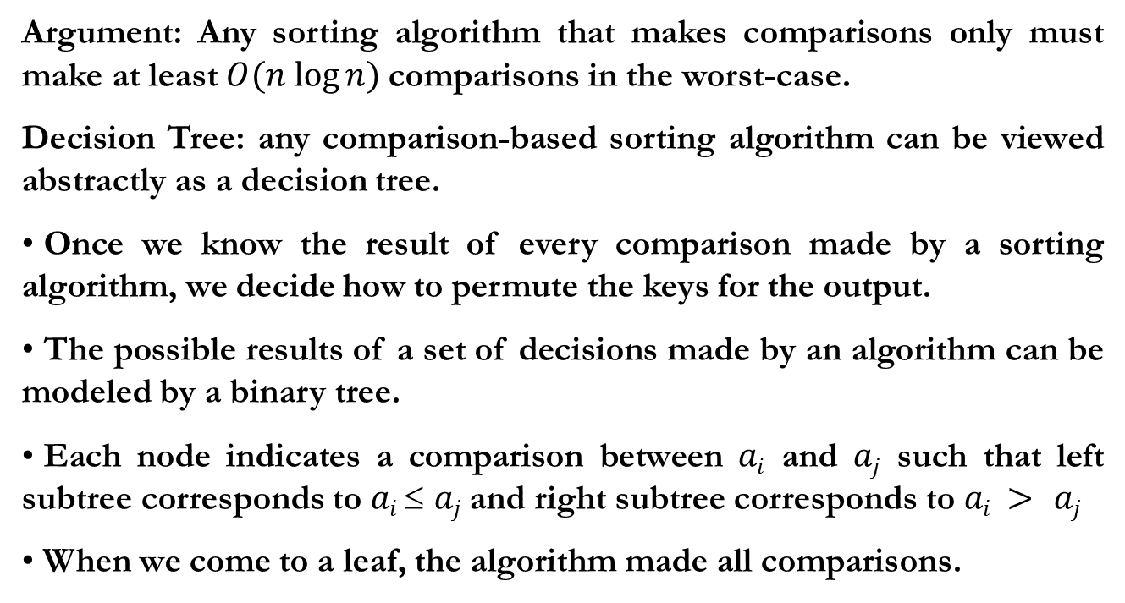
General Lower Bound for Sorting
Argument: Any sorting algorithm that makes comparisons only must make at least $O(n log⁡n)$comparisons in the worst-case.
Decision Tree: any comparison-based sorting algorithm can be viewed abstractly as a decision tree.
Once we know the result of every comparison made by a sorting algorithm, we decide how to permute the keys for the output.
The possible results of a set of decisions made by an algorithm can be modeled by a binary tree.
Each node indicates a comparison between $ai$ and $aj$ such that left subtree corresponds to $ai  aj$and right subtree corresponds to $ai > aj$
When we come to a leaf, the algorithm made all comparisons.
Notes:
35

Slide 36
Decision Tree: An Example
a < b < c
a < c < b
b < a < c
b < c < a
c < a < b
c < b < a
a < b
b < a
a : b
a < b < c
a < c < b
c < a < b
b < a < c
b < c < a
c < b < a
a < c
a : c
c < a
b < c
b : c
c < b
a < b < c
a < c < b
c < a < b
b < a < c
b < c < a
c < b < a
b < c
b : c
c < b
a < c
a : c
c < a
a < b < c
a < c < b
b < a < c
b < c < a
The worst-case running time is the length of the longest path in the decision tree.
Notes:
36

Slide 37
Decision Tree
Lemma: Any decision tree for a comparison-based sorting algorithm has height $(n log⁡n)$
Proof: Since any sorting algorithm will act differently on each of $n!$ possible permutations, the decision tree has at least $n!$leaves (actually it may have more because most algorithms perform redundant comparisons). It is well known that a binary tree of height $h$ has no more than $2h$leaves so$2h ≥$ $n!$, implying $h ≥ log⁡(n!)$
Notes:
37

Slide 38
Linear Time Sorting
If we want to sort faster than $O(n log⁡n),$we cannot do it by making comparisons only. Many applications involve sorting small integers (e.g., sort students according to their grade on the exam.)
Counting Sort sorts in $O(n)$ when each input is an integer in the range from 1 to $k$ ($k ∈ O(n))$
Determine for each element in the input its rank in the list, which is the number of elements that are less than or equal to it.
Once you know the rank, you sort by simply copying its element to the appropriate location of the final sorted output array.
Notes:
38

Slide 39
Counting Sort (Bucket Sort)
Use three arrays
A[1..n] : Holds the initial input
B[1..n] : Holds the sorted output
C[1..k] : C[i] serves two purposes, first to store the number of items equal to i in A[], and later to store the number of items less than or equal to i in A[]. The rank of A[j] will be C[A[j]]. We copy A[j] to B[C[A[j]]]; some care is needed for duplicate items.
Notes:
39

Slide 40
Counting Sort: An Example
1
2
3
4
5
1
2
3
4
1
2
3
4
A
1
4
3
1
3
C
2
0
2
1
C
2
2
4
5
1
2
3
4
5
1
2
3
4
1
2
3
4
5
A
1
4
3
1
3
C
2
2
3
5
B
3
1
2
3
4
5
1
2
3
4
1
2
3
4
5
A
1
4
3
1
3
C
1
2
3
5
B
1
3
1
2
3
4
5
1
2
3
4
1
2
3
4
5
A
1
4
3
1
3
C
1
2
2
5
B
1
3
3
1
2
3
4
5
1
2
3
4
1
2
3
4
5
A
1
4
3
1
3
C
1
2
2
4
B
1
3
3
4
1
2
3
4
5
1
2
3
4
1
2
3
4
5
A
1
4
3
1
3
C
0
2
2
4
B
1
1
3
3
4
Notes:
B의 특정 구간을 채울 때 뒤에서부터 채워야 C의 값이 의미 있음. 따라서 A도 뒤에서부터 scan해야 stable함.

Slide 41
Counting Sort (Code)
CountSort( A[1..n], B[1..n], k )
{
for( i = 1; k; i++)
C[i] = 0;
for( j = 1; n; j++)
C[A[j]]++;
/* C[i] has the number of elements of A equal to i */
for(i = 2; k; i++)
C[i] += C[i-1];
/* C[i] has the number of elements in A that is <= i */
for(j = n; 1; j--)
B[C[A[j]]--] = A[j];
}
Running Time: $O(n)$
Why did the last for loop run DOWN, rather than UP?
This does not affect the answer, but affects the stability of the algorithm!!!
Notes:
41

Slide 42
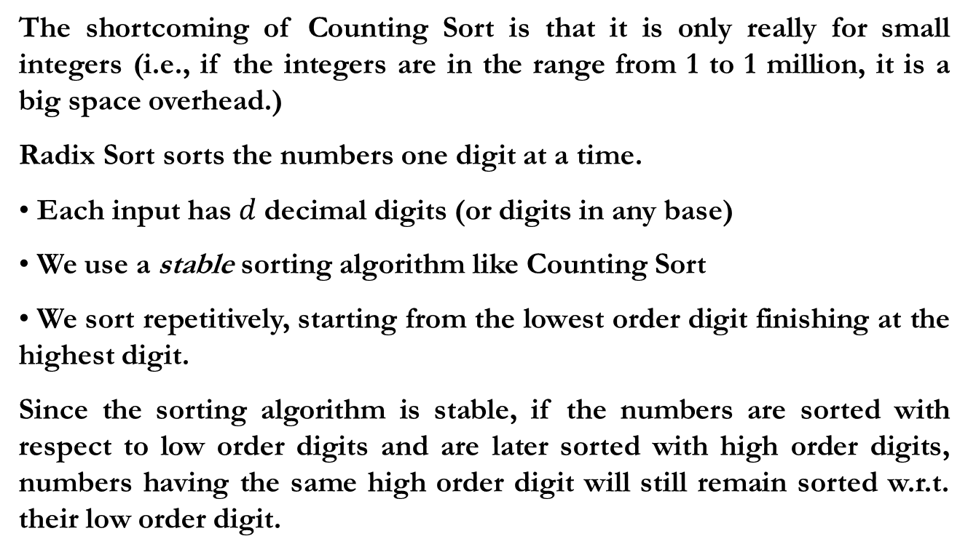
Radix Sort
The shortcoming of Counting Sort is that it is only really for small integers (i.e., if the integers are in the range from 1 to 1 million, it is a big space overhead.)
Radix Sort sorts the numbers one digit at a time.
Each input has $d$decimal digits (or digits in any base)
We use a stable sorting algorithm like Counting Sort
We sort repetitively, starting from the lowest order digit finishing at the highest digit.
Since the sorting algorithm is stable, if the numbers are sorted with respect to low order digits and are later sorted with high order digits, numbers having the same high order digit will still remain sorted w.r.t. their low order digit.
Notes:
42

Slide 43
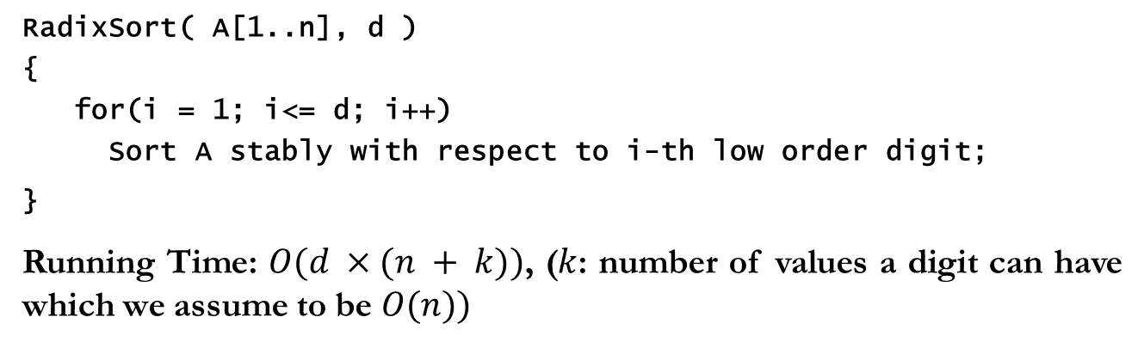
Radix Sort Algorithm and An Example
RadixSort( A[1..n], d )
{
for(i = 1; i<= d; i++)
Sort A stably with respect to i-th low order digit;
}
Running Time: $O(d ×(n + k))$, ($k$: number of values a digit can have which we assume to be $O(n))$
2 4 6
9 2 3
9 2 3
2 3 8
9 2 5
9 2 5
9 2 5
2 4 6
2 3 8
2 4 6
2 3 8
9 2 3
9 2 3
2 3 8
2 4 6
9 2 5
Notes:
43

Slide 44
Radix Sort
512 64 216 125 0 27 8 343 729 1
Buckets after the first step of Radix Sort
0
1
512
343
64
125
216
27
8
729
0
1
2
3
4
5
6
7
8
9
Buckets after the second pass of Radix Sort
8
729
1
216
27
0
512
125
343
64
0
1
2
3
4
5
6
7
8
9
Buckets after the last pass of Radix Sort
64
27
8
1
0
125
216
343
512
729
0
1
2
3
4
5
6
7
8
9
Notes:
44

Slide 45
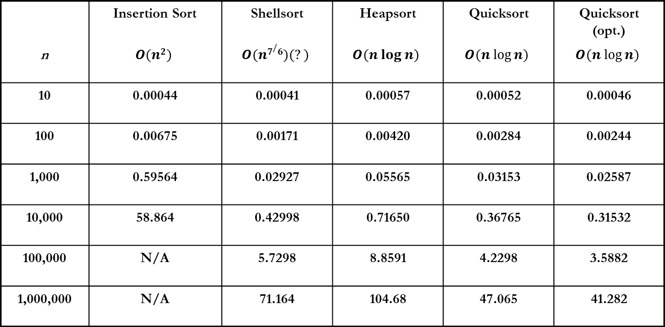
Comparison of Sorting Algorithms
(unit: seconds)
 | Insertion Sort | Shellsort | Heapsort | Quicksort | Quicksort (opt.)
n | $$O(n2)$$ | $$O(n7/6)(?)$$ | $$O(n log n)$$ | $$O(n log⁡n)$$ | $$O(n log⁡n)$$
10 | 0.00044 | 0.00041 | 0.00057 | 0.00052 | 0.00046
100 | 0.00675 | 0.00171 | 0.00420 | 0.00284 | 0.00244
1,000 | 0.59564 | 0.02927 | 0.05565 | 0.03153 | 0.02587
10,000 | 58.864 | 0.42998 | 0.71650 | 0.36765 | 0.31532
100,000 | N/A | 5.7298 | 8.8591 | 4.2298 | 3.5882
1,000,000 | N/A | 71.164 | 104.68 | 47.065 | 41.282
* QuickSort (optimized): Cutoff used for small size inputs, median-of-three partitioning
Notes:
45

